Slide 1
IOT
SMART STREET LIGHT MONITORING AND CONTROLLING

Slide 2
SUMBITTED BY:
NAME : SREENA VR
ROLL NO : LLMC17MCA030
DEPT : MCA
SEMESTER : 6th

Slide 3
Abstract
Smart Street Light Monitoring and Controlling
“
“
The project entitled “IOT based Smart Street Light Monitoring and Controlling” is developed for automatic street light monitoring to ensure, low power consumption, consumption monitoring, instant faulty light detection and light dimming as per external lighting conditions and also light dimming through motion detection. The application is designed in such a way that we place light sensors in all street light circuits, which is responsible for switching off and on automatically. Once the lights are switched on current sensors placed at every street light are responsible to report problem status to the centralized system with help of Wi-Fi module attached with the circuit.

Slide 4
Aim of the project
01
Dim and Bright Technology
PIR sensor is used for dim and bright technology.
02
Fault Light Detection
Can simply identify the fault light using position number.
03
Current Consumption
Identifies current consumption using Current sensor.
04
Auto Switch ON/OFF
Automatically switching on/off of light using LDR.

Slide 5
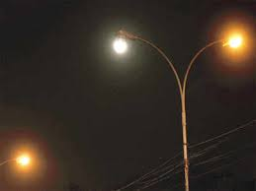

EXISTING SYSTEM
Manual Switching ON/OFF Technology
Street light is poorly designed and inadequately maintained, there are large number of burned out lamps which leads to insecurity. There is a complaint register in every zonal office street light section. It is being maintained by the line inspector. The complaint received from public, councilors and corporation officials either over phone is in person being recorded in the complaint register.
More Manpower
The complaint thus entered is being handed over to the fieldwork man so as to rectify the complaints, the field staff will have the rounds in the respective areas twice in a week and the complaints about non burning are also being attended then and there.

Slide 6
Drawbacks of Existing system
Manually Switching ON/OFF of Street Lights
High Expense
A
B
C
D
More Energy Consumption
More Manpower

Slide 7
PROPOSED SYSTEM
Automatic Street Light Control System Using Microcontroller aims at designing executing the advanced development in embedded systems for energy saving of street lights.
Smart Street Light Monitoring and Controlling gives the best solution for electrical
power wastage. Also manual operation of the lighting system is completely eliminated.
In here three sensors are used which are Light Dependent Resistor LDR sensor to indicate a day/night time and the PIR sensors to detect the movement on the street and ACS712 current sensor used for sensing the total consumption of current .
The microcontroller 328 is used as brain to control the street light system, where the programming language used for developing the software to the microcontroller is C-language.
The purpose of this work is to describe the Intelligent Street Lighting (ISL) system, a first approach to accomplish the demand for flexible public lighting systems.

Slide 8
Features Of Proposed System
LDR automatically on/off the light according to the intensity of natural light.
Automatic Switching of Lights
We can save energy through automatically dimming of lights.
Energy Saving
Wireless Communication
We can communicate via Wi-Fi module through Blynk and ThingSpeak.
Maintenance cost reduction
Reduction of manpower
Can reduce the maintenance cost through automatically detecting faulty lights.
Easily reduce manpower through automation.

Slide 9
HARDWARE REQUIREMENTS
01
02
03
04
05
Arduino Atmega 328
Light Dependent Resistor
Relay
ACS712 30A(current sensor)
Passive Infrared Sensor

Slide 10
BLOCK DIAGRAM
PIR
Atmega 328
Monitoring Station
Current
Sensor
Relay
L
S
LDR

Slide 11
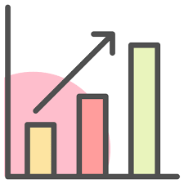

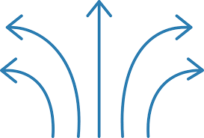
ThingSpeak
ThingSpeak is an IoT analytics platform service that allows you to aggregate, visualize, and analyze live data streams in the cloud. You can send data to ThingSpeak from your devices, create instant visualization of live data, and send alerts. With the ability to execute MATLAB code in ThingSpeak you can perform online analysis and processing of the data as it comes in. ThingSpeak is often used for prototyping and proof of concept IoT systems that require analytics.
Collect Analyze Act

Slide 12

BLYNK
Blynk is a new platform that allows you to quickly build interfaces for controlling and monitoring your hardware projects from your iOS and Android device. After downloading the Blynk app, you can create a project dashboard and arrange buttons, sliders, graphs, and other widgets onto the screen.
How it works:
Create a Blynk Account. After you download the Blynk App, you'll need to create a New Blynk account.
Create a New Project. After you've successfully logged into your account, start by creating a new project.
Choose Your Hardware.
Authentication of Token.
Add a Widget.
Run The Project.

